Slide 1
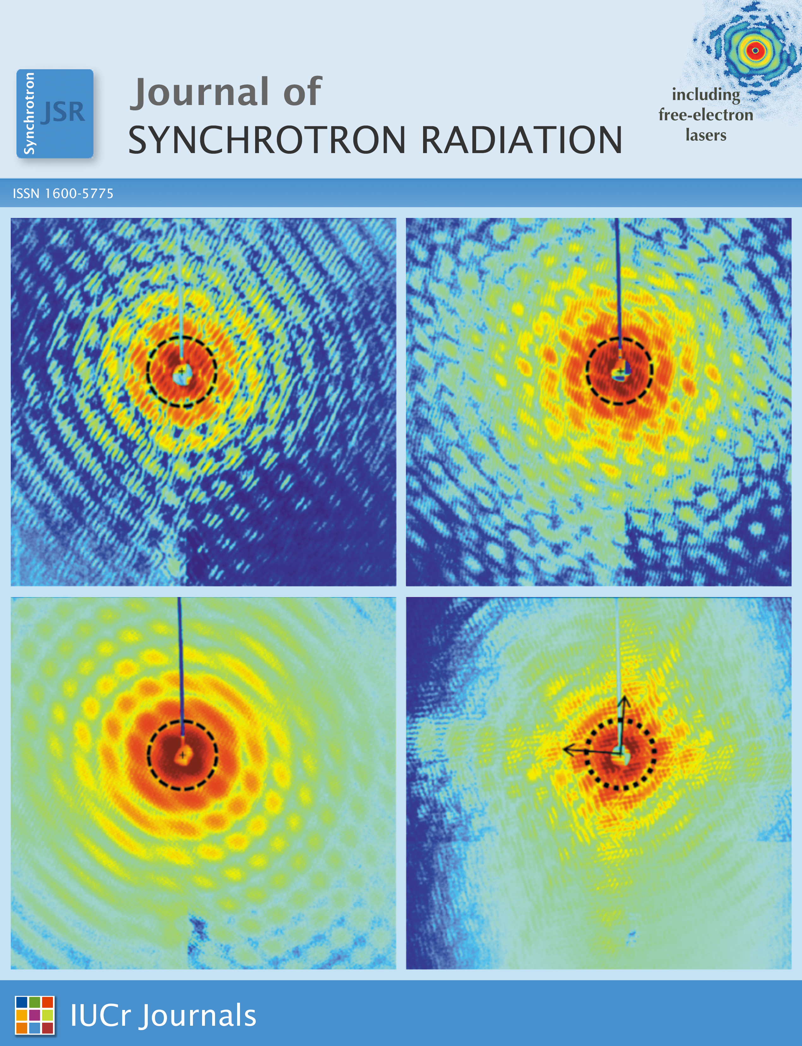
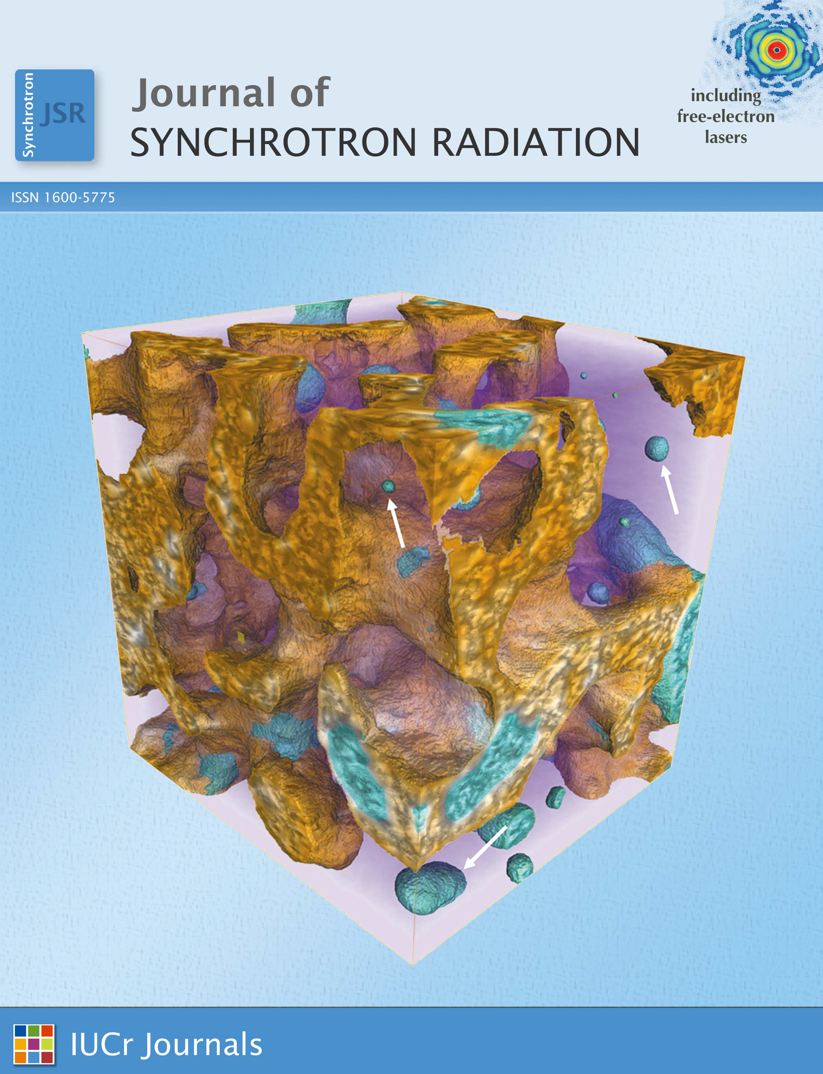
journals.iucr.org/s/ @JSynchrotronRad
Journal of Synchrotron Radiation

